Slide 1
Algorithmic Auditing
Ashar Farooq

Slide 2
What is algorithmic auditing?
A set of techniques for testing whether an intelligent machine has blind spots or biases. We feed the machine a variety of inputs and look for problematic patterns in decision‑making.

Slide 3
Questions to consider
How do I optimally model and use the patterns in this data?
Is this sample of data suitably representative of the underlying reality?
Is the distribution based on today’s reality the appropriate one to use?
Is the algorithm suitably transparent to end-users?
Is it likely to be used in a socially acceptable way?
Is the algorithm being used for a deceptive purpose?
Might it produce undesirable psychological effects or inadvertently exploit natural human frailties?
Is there evidence of internal bias or incompetence in its design?
Is it adequately reporting how it arrives at its recommendations and indicating its level of confidence?
If I provide questionable training data, how bad is the result?
If I provide good training data, how good is the result?
If I provide too much data, how accurate is the result?
If I provide too little data, how accurate is the result?
What can I say about the algorithm’s accuracy, bias, consistency, transparency, fairness, and legal compliance?

Slide 4
Example:
Gender Shades: Intersectional Accuracy Disparities in Commercial Gender Classification
How well do IBM, Microsoft, and Face++ AI services guess the gender of a face?
Investigators:
Joy Buolamwini | joyab@mit.edu | MIT Media Lab
Timnit Gebru | timnit.gebru@microsoft.com

Slide 5
Gender Shades
The Gender Shades project evaluates the accuracy of AI powered gender classification products. It essentially “audits” different gender classification programs(i.e. Microsoft, IBM Watson Visual Recognition, Face++) and compares accuracies.
This evaluation focuses on gender classification as a motivating example to show the need for increased transparency in the performance of any AI products and services that focused on human subjects. Bias in this context is defined as having practical differences in gender classification error rates between groups.

Slide 6
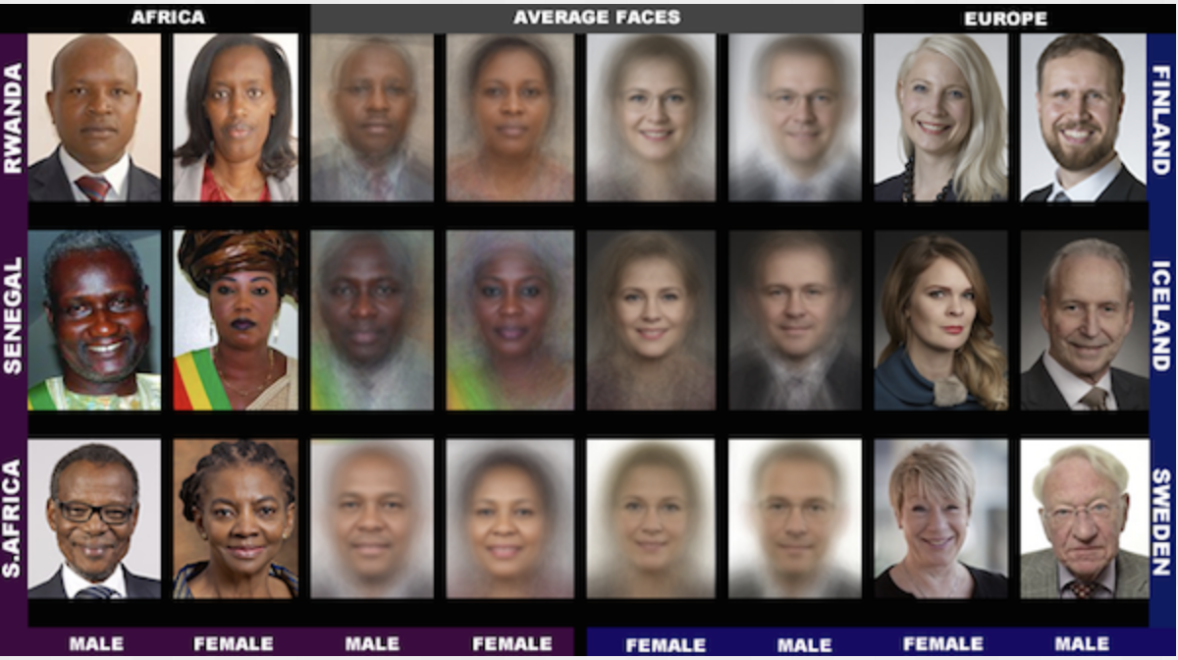
1270 images were chosen to create a benchmark for this gender classification performance test.

Slide 7
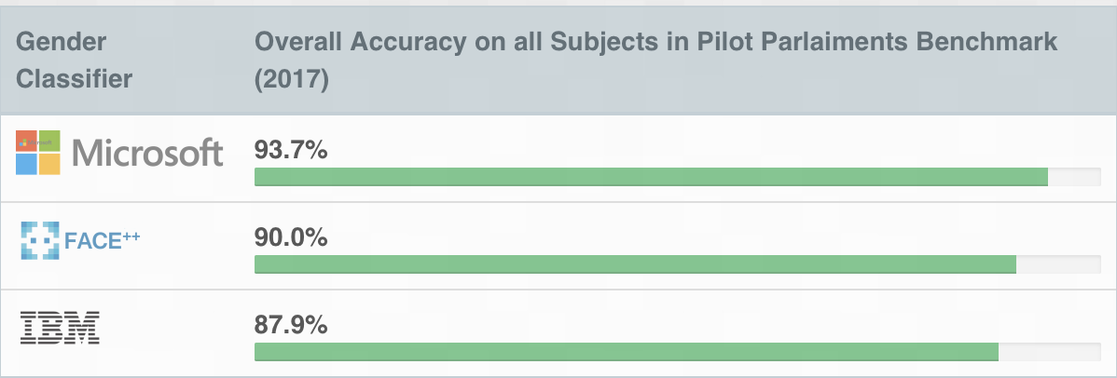
Three companies - IBM, Microsoft, and Face++ - that offer gender classification products were chosen for this evaluation based on geographic location and their use of artificial intelligence for computer vision.

Slide 8
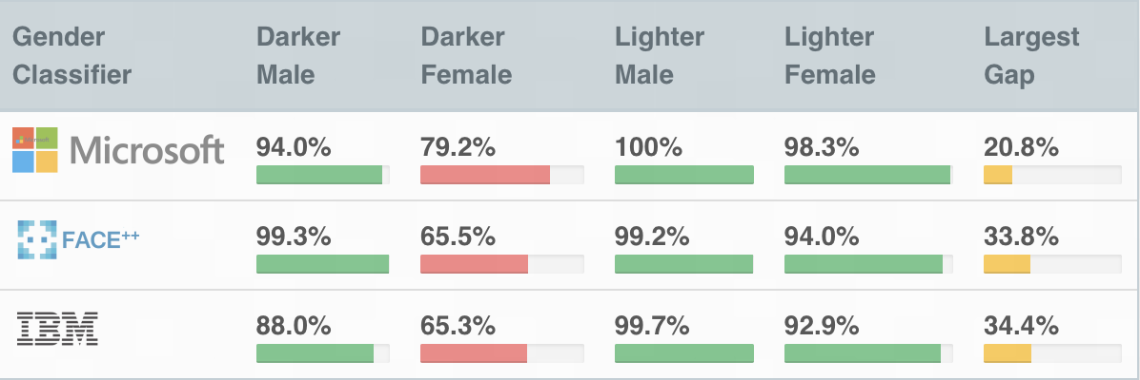
While the companies appear to have relatively high accuracy overall,there are notable differences in the error rates between different groups.

Slide 9
This one research project audit of IBM Watson Visual Recognition program prompted this IBM response.
IBM did their own audit using a similar, but slightly different process involving slight change in the data and labels, showing the biased responses as well although at a lower level than was presented in the Gender Shades project.

Slide 10
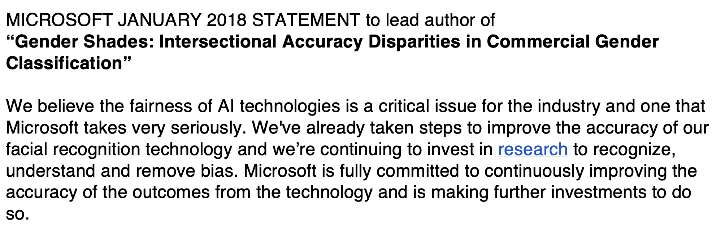
Microsoft Response

Slide 11
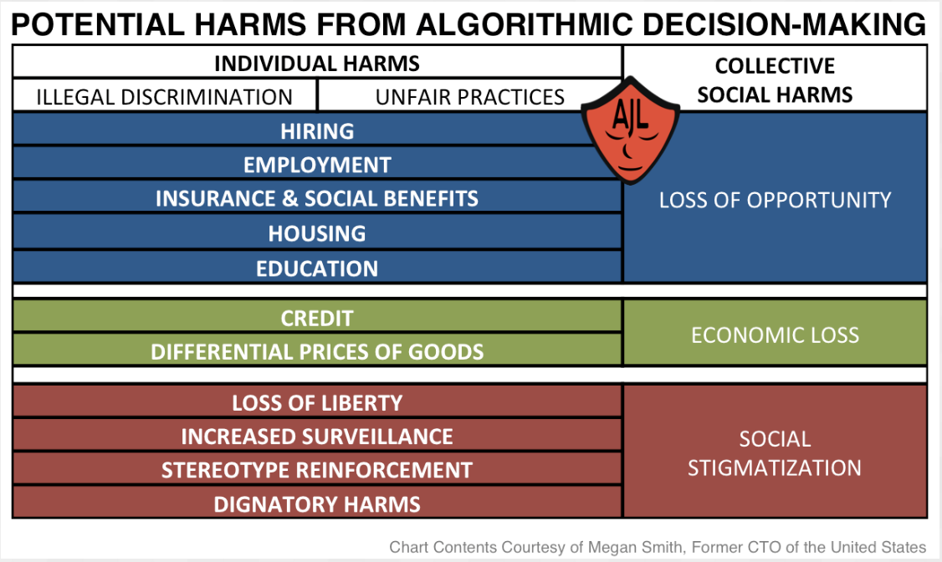

Slide 12
Algorithmic Accountability
Algorithmic Justice League: raise public awareness about the impacts of AI, equip advocates with empirical research to bolster campaigns, build the voice and choice of most impacted communities, and galvanize researchers, policymakers, and industry practitioners to mitigate AI bias and harms.
O'Neil Risk Consulting & Algorithmic Auditing(ORCAA): a consulting company that helps companies and organizations manage and audit their algorithmic risks; It examines everything from the people who programmed the software to the training data to the output, flagging any bias in the process.
Founded
By
Joy
Buolamwini
Cathy O’Neil
Wrote is a
mathematician
Who wrote a
popular
Book on
big data and
inequity

Slide 13
What does ORCAA do?
Identify stakeholder groups: the people who will be impacted by the algorithm’s success or failure.
Facilitate a discussion among people who can represent those stakeholder groups. What are their concerns, positive and negative, in how the algorithm works?
Prioritize concerns: which present the biggest risks? Which need to be addressed most urgently?
We develop guidance to address and remediate priority concerns.
The Algorithmic Audit typically centers on a 2-day onsite visit, where ORCAA learns about the algorithm in context, meets with stakeholders, and facilitates the creation of a draft Ethical Matrix.

Slide 14
Trends
The EU’s General Data Protection Regulation (GDPR) requires that organizations be able to explain their algorithmic decisions[“Standard supervised machine learning algorithms for regression or classification are inherently based on discovering reliable associations / correlations to aid in accurate out-of-sample prediction, with no concern for causal reasoning or ‘‘explanation’’ beyond the statistical sense in which it is possible to measure the amount of variance explained by a predictor.”]
The city of New York recently assembled a task force to study possible biases in algorithmic decision systems. It released a report publicly that’s been criticized for not having any strong policy measures.

